Slide 1
LEAVE MANAGEMENT SYSTEM

Slide 2
TEAM MEMBERS
SAMPRADA.R (2KL16CS077)
VIDYA NARAYAN KAVADI (2KL16CS113)

Slide 3
INTRODUCTION
The “Leave Management System” has been developed to override the problems prevailing in the practicing manual system.
This software is supported to eliminate and in some cases reduce
hardships faced by existing system so that their valuable
data/information can be stored for longer period with easy
accessing and manipulation of same.
It provides error messages while entering invalid data . No formal
knowledge is needed for the user to use this system.
Leave Management System can lead to error free , secure ,reliable and fast
management system

Slide 4
OBJECTIVE
The objective of the project is to reduce the paper work and easier maintainence of records of leaves of faculty.
Initially faculty had to submit their leaves manually to their higher authority.
This increases the paper work and makes it difficult to maintain the records.
The project is totally built at administrative end and thus only the administrator is guaranteed the access.
The purpose of Leave Management System is to automate the existing manual system by the help of computerized equipments and full-fledged computer software , fulfilling their requirements.

Slide 5
MODULES:
The project contains four modules:
Faculty
HOD
Principal
Administrator
1.Faculty Module
Initially Faculty logins into in account by entering username and password.
View leave details and Class Adjustment Details
The faculty can view the leave details.
The classes adjusted by him/her and also the classes adjusted to him/her.
Apply Leave
The faculty can apply for leave by sending an application to higher authority with a reason for leave and number of days of leave , start date and end date
Cancel Leave
Faculty can cancel the leave , applied by him/her.
Logout
faculty can logout and go back to welcome page.

Slide 6
2.HOD Module
View leave details and Class Adjustment Details
HOD can view the leave details.
The classes adjusted by him/her and also the classes adjusted to him/her.
Apply Leave
The faculty can apply for leave by sending an application to higher authority with a reason for leave and number of days of leave , start date and end date
Approve leave
HOD can view the leave applications of the faculty of a department and either
approve or reject the leaves
View Faculty Leave Details
HOD can view the Faculties who are on leave from and to date and reason.
Change Password
HOD can reset i.e change his/her password .
Logout
HOD can logout and go back to welcome page.

Slide 7
3. Principal Module
This module is the highest authority for all.
View leave details
Principal can view the leave records of all faculty for a given period.
View Faculty Leave Details
Principal can view the Faculties who are on leave from and to date and reason.
Approve leaves
Principal can approve or reject the leave applications of all faculty once it has been
approved by the HODs.
Change Password
Principal can reset i.e change his/her password .
Logout
Principal can logout and go back to welcome page.

Slide 8
4. Administrator
Administrator plays important role in Leave Management System.
Administrator after logging into his account ,he has the authority to register faculty.
He can update the details of the faculty working for the department.
He can remove the faculty details.
He can change password for his login page , as well as logout when required.

Slide 9
Problem Statement
It is a Web based application where a faculty and hod can apply leave. Hod or the faculty can also adjust his or her classes to another faculty, when he or she is on leave. First the leave has to be approved by the hod then followed by the principal, then only the leave will be granted to the faculty or hod.
Software Requirements
Oracle 11g:Database
NetBeans 8.2 IDE
Tomcat server
HARDWARE REQUIREMENTS
RAM:4GB
Hard Disk: 3GB

Slide 10
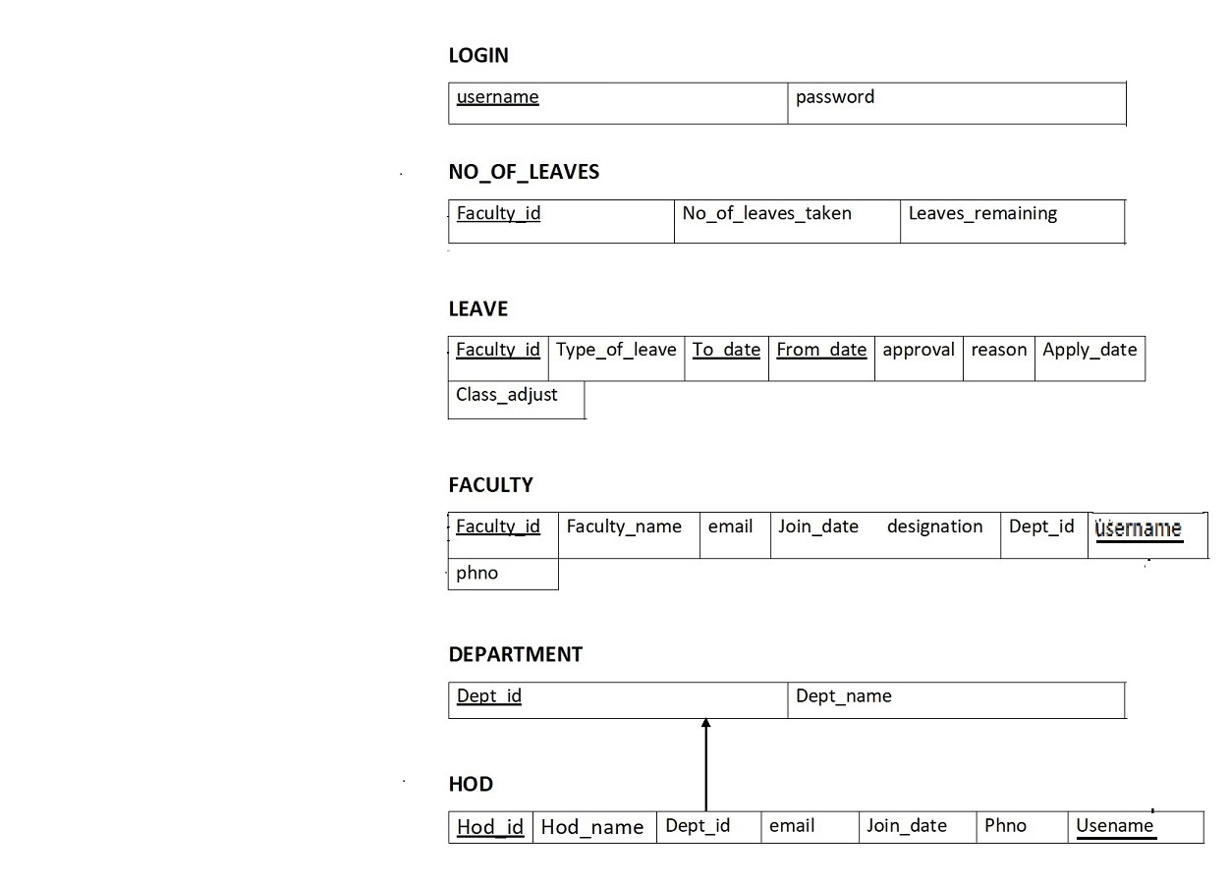
SCHEMA DIAGRAM

Slide 11
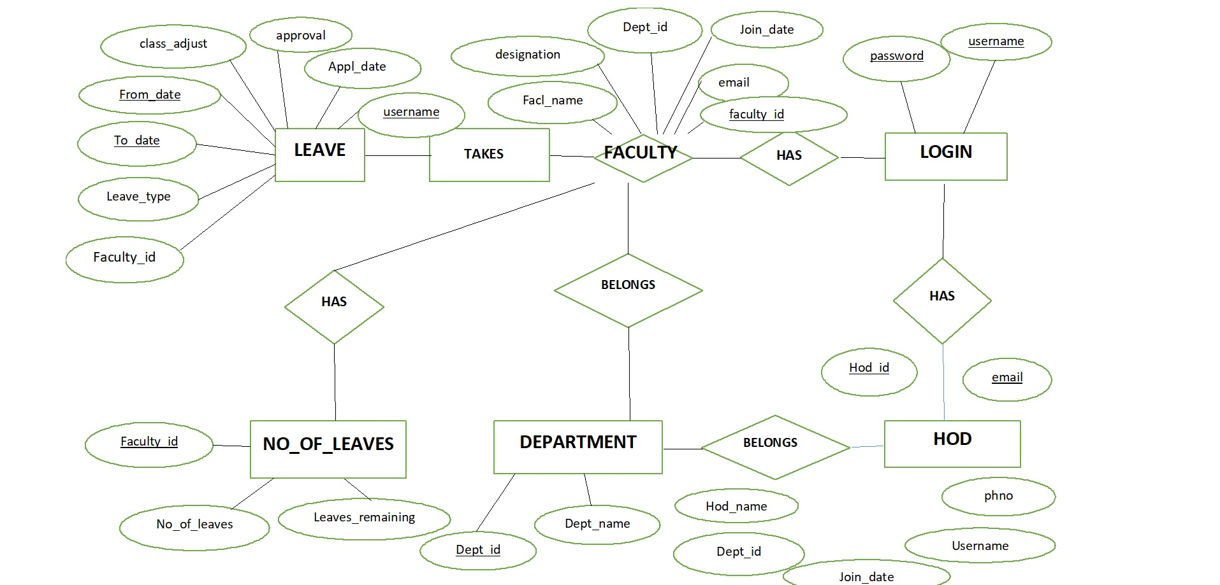
ER DIAGRAM

Slide 12
Advantages
Leave Management System maintains the leave records of faculty.
It reduces the paper work and manual work done by the faculty .Thus making it
easier to maintain records.
The higher authorities can view the leave records. They can accept or reject the
leaves requested by faculty. Thus the system maintains the excess amount of job
done by the college.
This software is supported to eliminate and in some cases reduce
hardships faced by existing system so that their valuable
data/information can be stored for longer period with easy
accessing and manipulation of same.
Leave Management System, as described above can lead to error free , secure,
reliable and fast management system.

